Slide 1

MSSP 608 Lecture 1

Slide 2

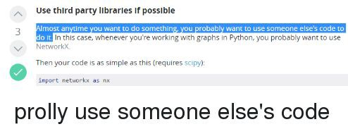
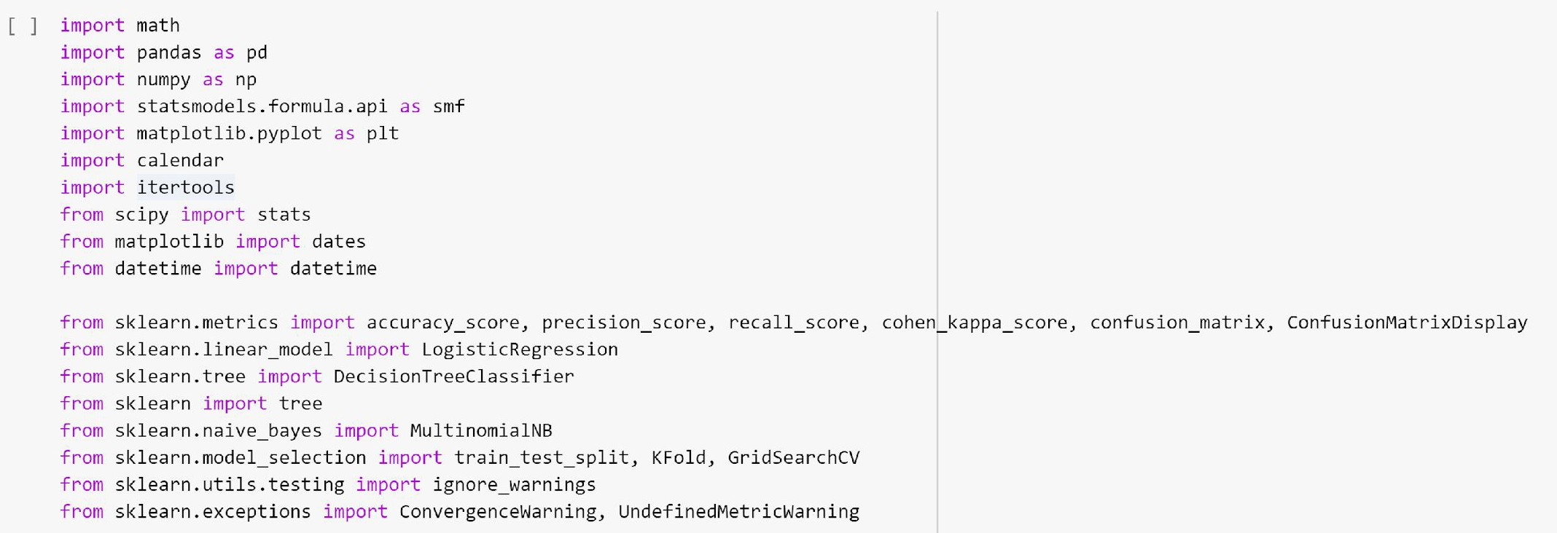
What do all these imports do

Slide 3


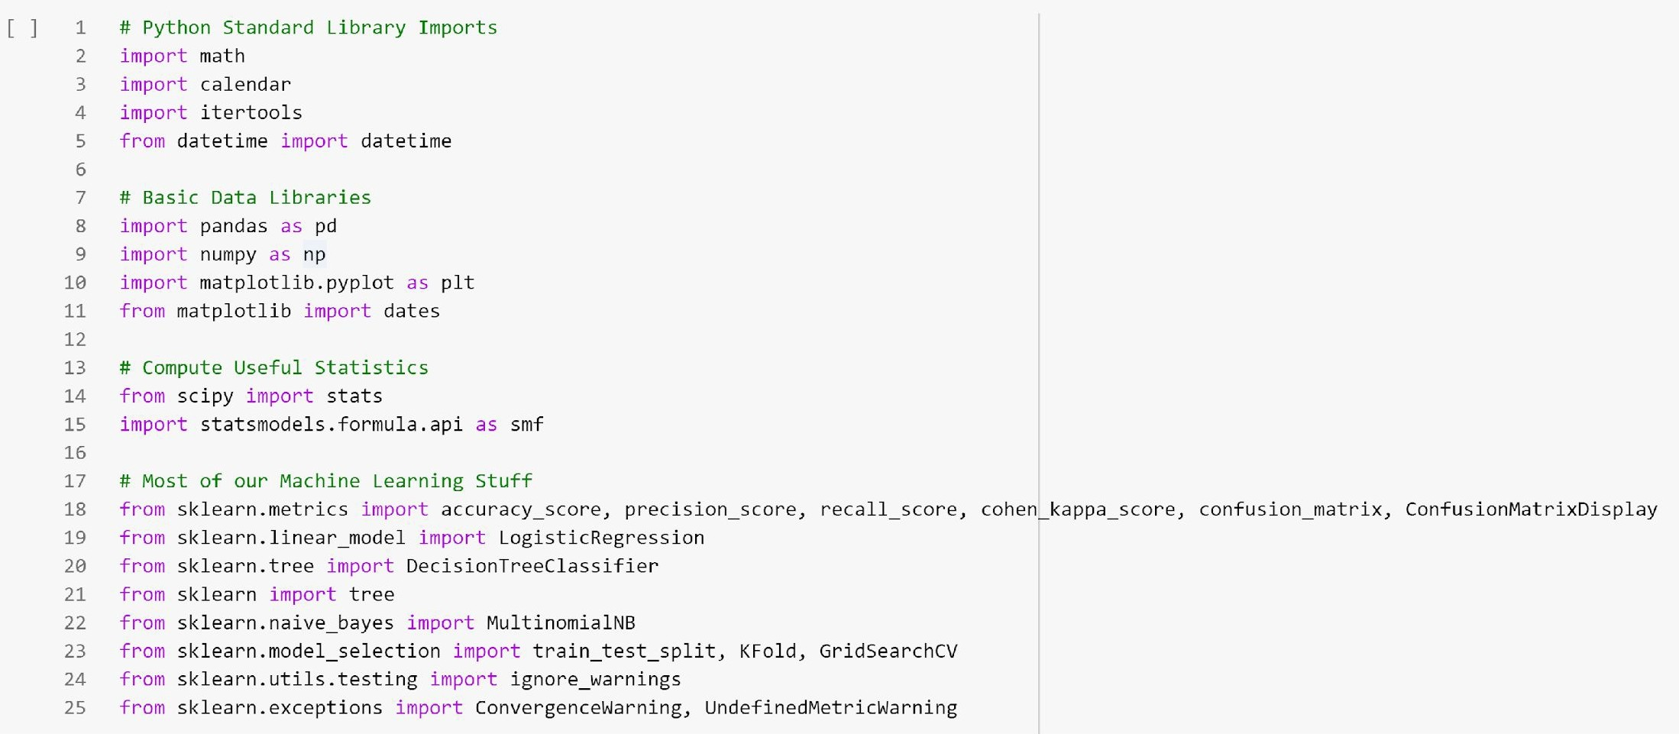
Let’s break this down into parts

Slide 4

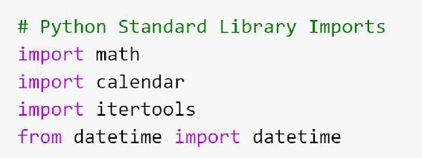

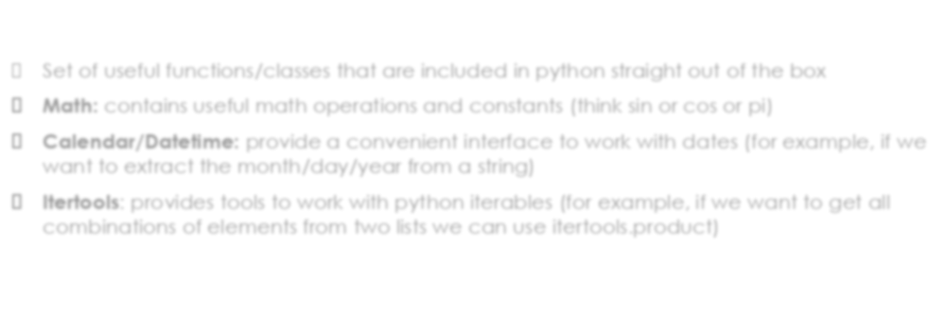
Python Standard Library
□ Set of useful functions/classes that are included in python straight out of the box
Math: contains useful math operations and constants (think sin or cos or pi)
Calendar/Datetime: provide a convenient interface to work with dates (for example, if we want to extract the month/day/year from a string)
Itertools: provides tools to work with python iterables (for example, if we want to get all combinations of elements from two lists we can use itertools.product)

Slide 5
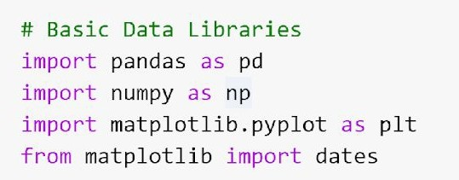

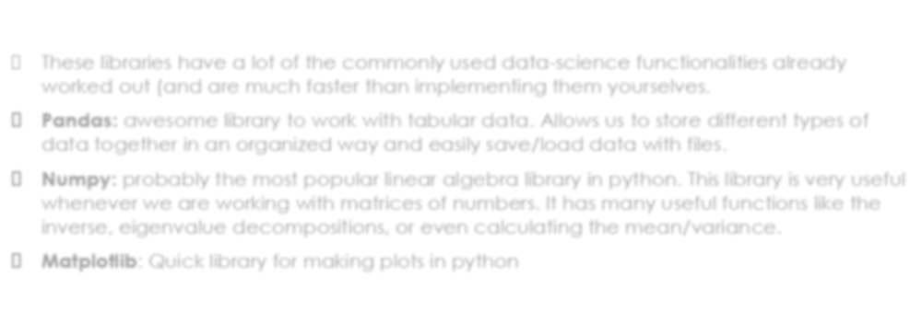

Basic Data Libraries
□ These libraries have a lot of the commonly used data-science functionalities already worked out (and are much faster than implementing them yourselves.
Pandas: awesome library to work with tabular data. Allows us to store different types of data together in an organized way and easily save/load data with files.
Numpy: probably the most popular linear algebra library in python. This library is very useful whenever we are working with matrices of numbers. It has many useful functions like the inverse, eigenvalue decompositions, or even calculating the mean/variance.
Matplotlib: Quick library for making plots in python

Slide 6


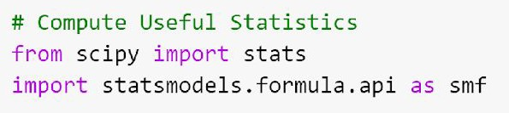
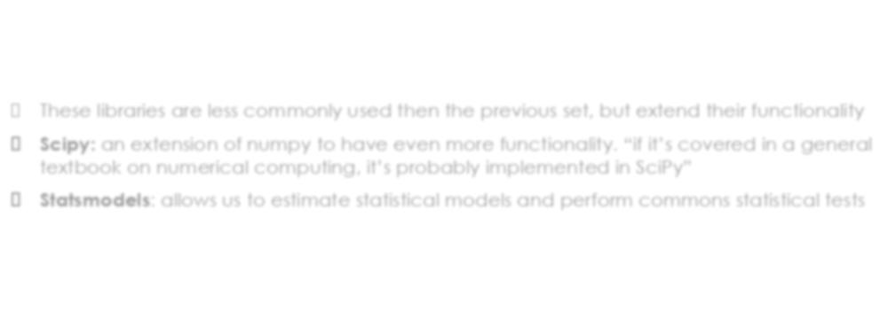
More Data Libraries
□ These libraries are less commonly used then the previous set, but extend their functionality
Scipy: an extension of numpy to have even more functionality. “if it’s covered in a general textbook on numerical computing, it’s probably implemented in SciPy”
Statsmodels: allows us to estimate statistical models and perform commons statistical tests

Slide 7

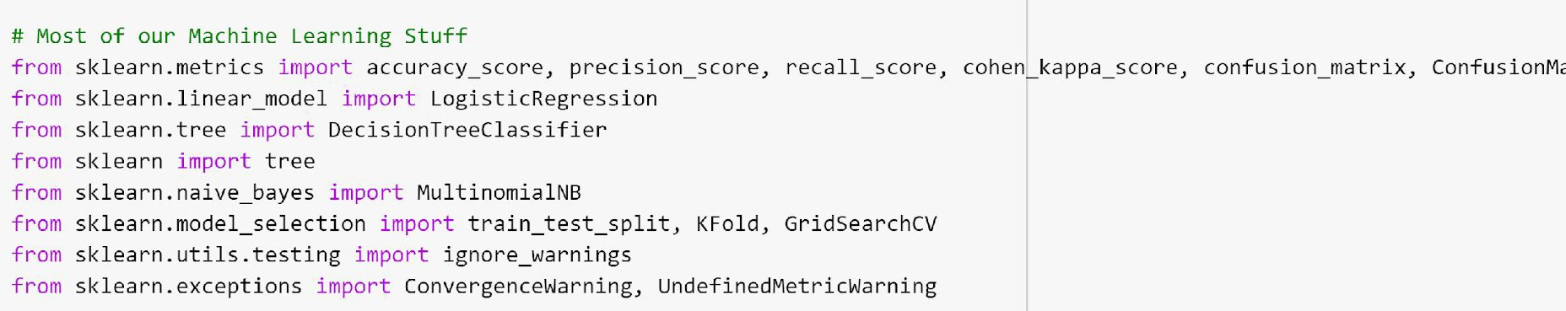


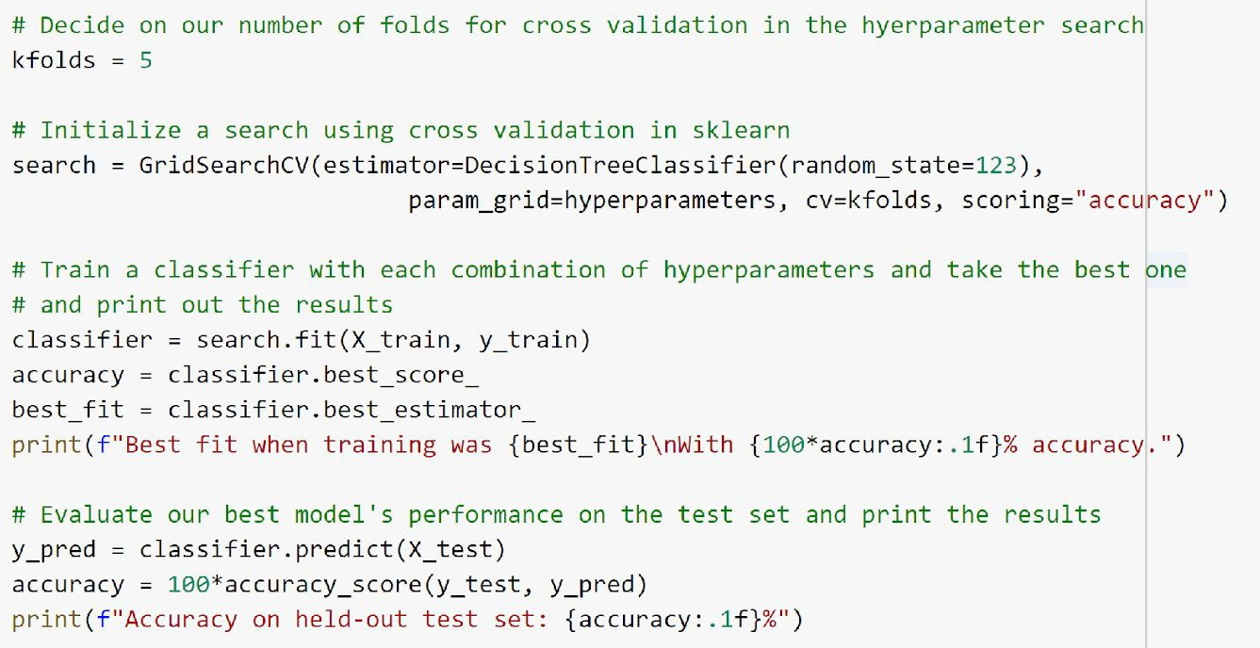
Scikit-Learn
Scikit-Learn contains most of the machine learning functionality that we could want
Notice that this is most of our imports
The great part about scikit-learn is that we can do a lot of experiments doing basically the same (small amount of) code

Slide 8


Hyperparameter Optimization
Brief Review of Hyperparameter Optimization

Slide 9


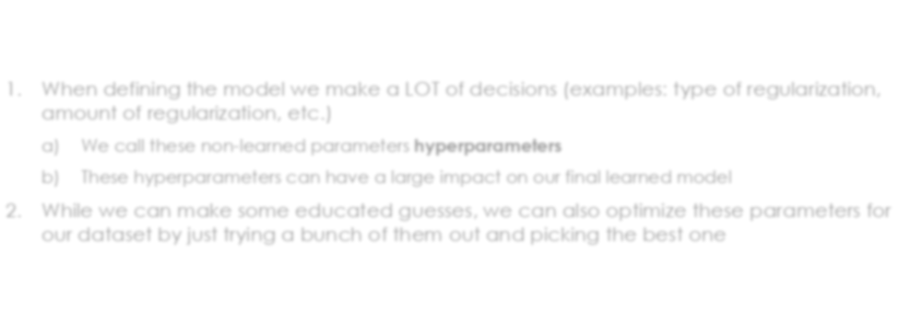
Core Ideas
When defining the model we make a LOT of decisions (examples: type of regularization, amount of regularization, etc.)
We call these non-learned parameters hyperparameters
These hyperparameters can have a large impact on our final learned model
While we can make some educated guesses, we can also optimize these parameters for our dataset by just trying a bunch of them out and picking the best one

Slide 10

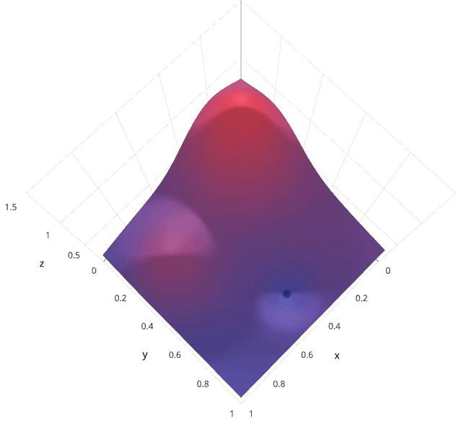
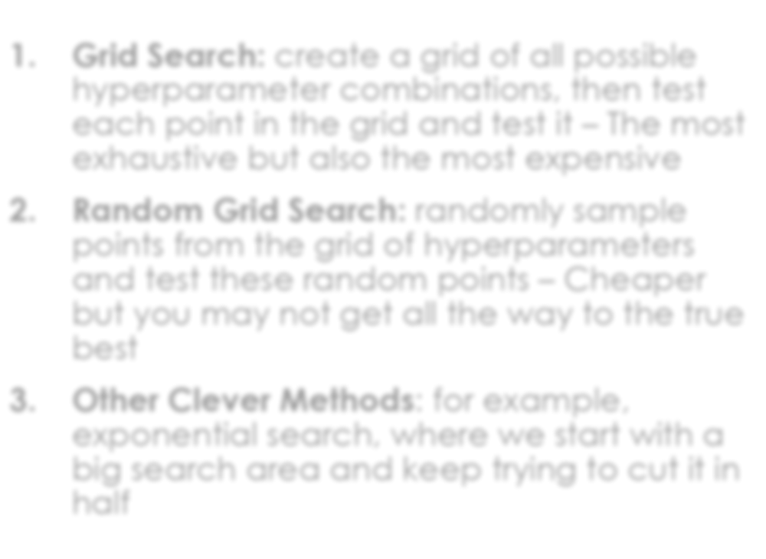
Ways to go about this
Grid Search: create a grid of all possible hyperparameter combinations, then test each point in the grid and test it – The most exhaustive but also the most expensive
Random Grid Search: randomly sample points from the grid of hyperparameters and test these random points – Cheaper but you may not get all the way to the true best
Other Clever Methods: for example, exponential search, where we start with a big search area and keep trying to cut it in half

Slide 11

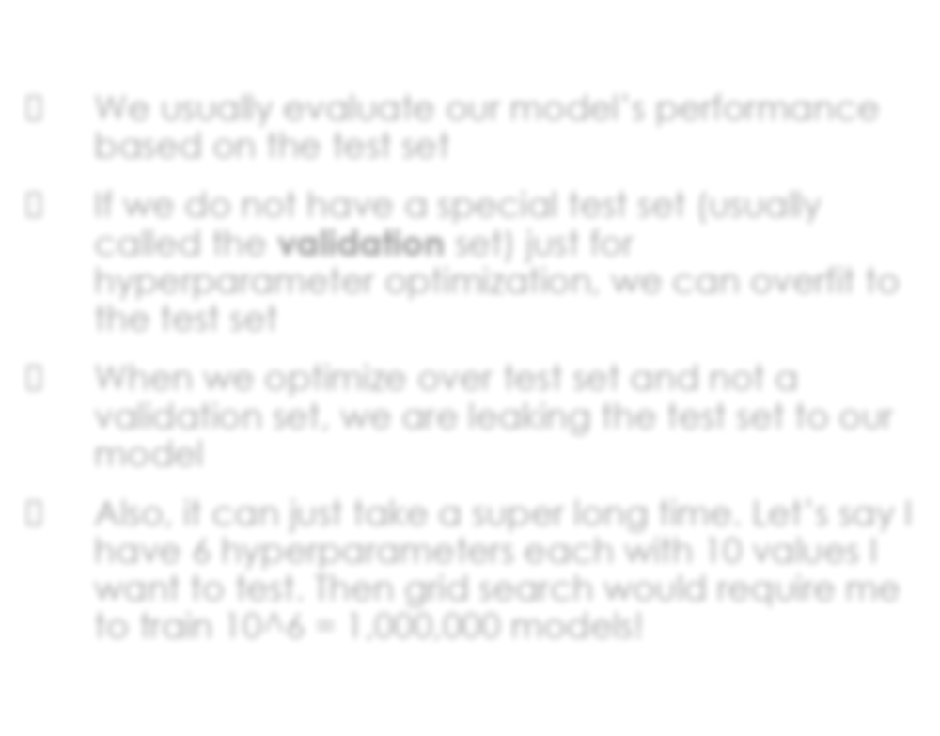
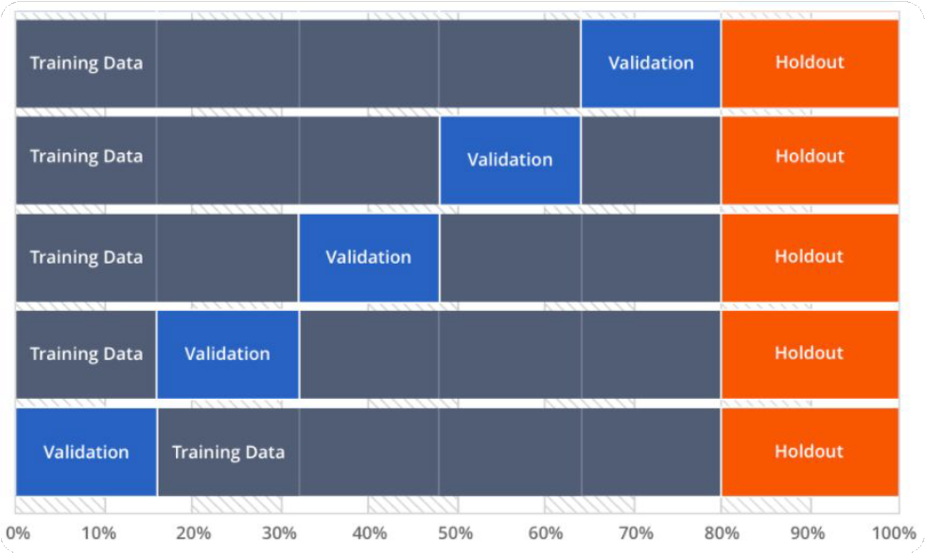
Dangers of Hyperparameter Optimization
We usually evaluate our model’s performance based on the test set
If we do not have a special test set (usually called the validation set) just for hyperparameter optimization, we can overfit to the test set
When we optimize over test set and not a validation set, we are leaking the test set to our model
Also, it can just take a super long time. Let’s say I have 6 hyperparameters each with 10 values I want to test. Then grid search would require me to train 10^6 = 1,000,000 models!

Slide 12


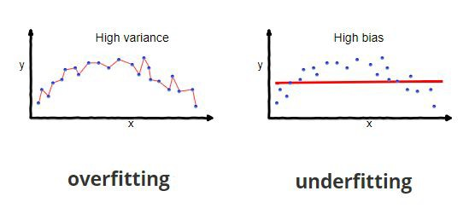

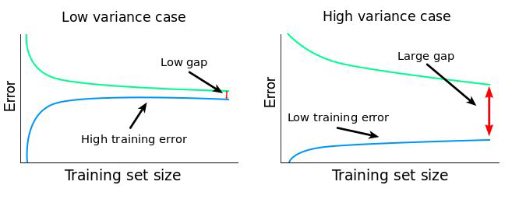
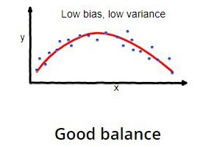
Bias/Variance Tradeoff

Slide 13


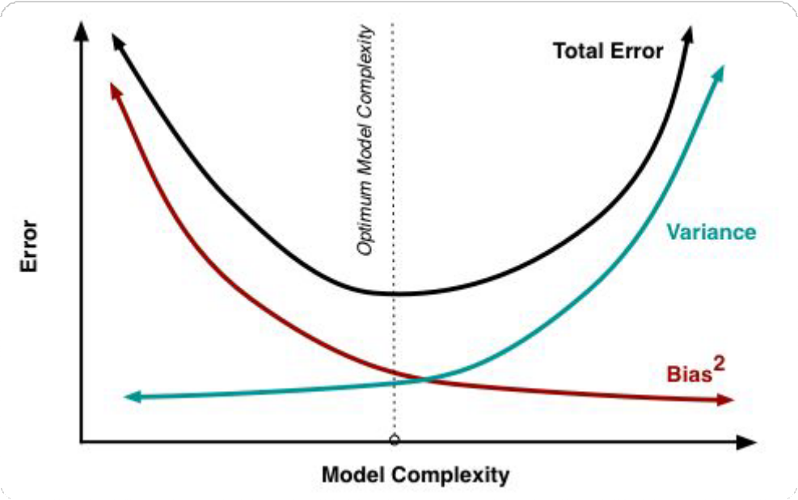
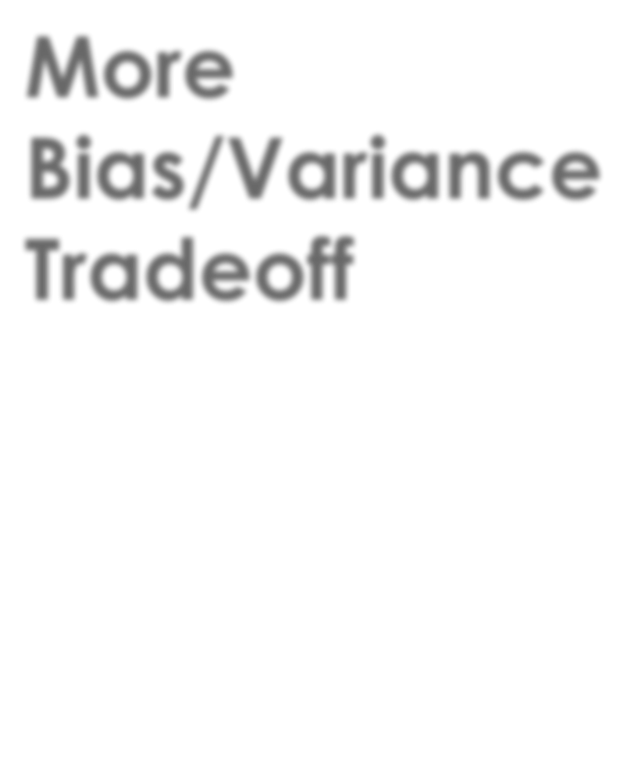
More Bias/Variance Tradeoff

